Slide 1
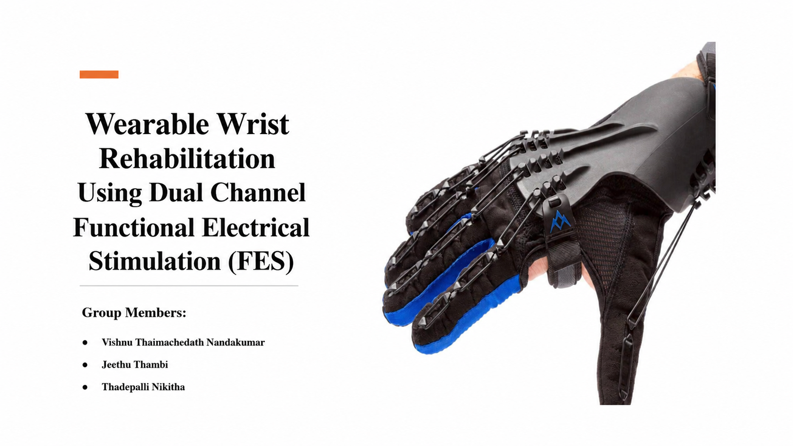

Slide 2
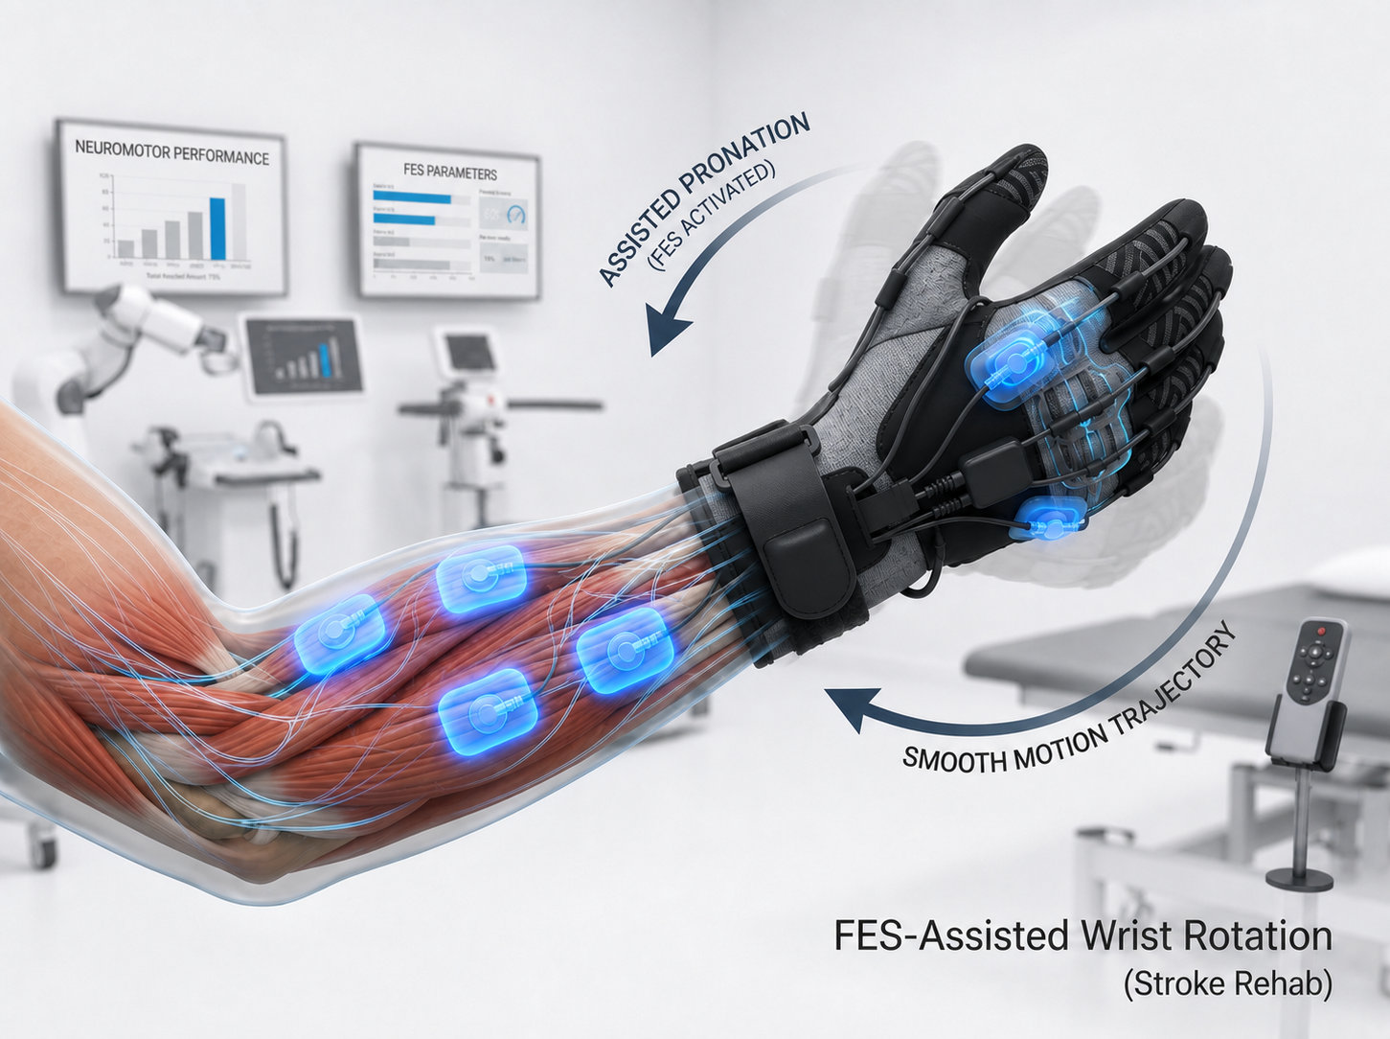
Introduction
Importance of wrist function in daily activities.
The wrist is essential for performing daily activities
Need for rehabilitation to restore mobility and independence.
Current limitations
Bulky mechanical rehabilitation devices.
High manufacturing and maintenance costs.
Limited portability for home use.

Slide 3
General Overview of the Project
The project aims to develop a lightweight, wearable rehabilitation system that assists wrist movement using Functional Electrical Stimulation (FES). Unlike conventional robotic rehabilitation devices that depend on mechanical actuators, the proposed system stimulates the user's forearm muscles to produce movement naturally. The system consists of a wearable glove, a forearm-mounted dual-channel FES module, sensing components, and a microcontroller for stimulation control. The design emphasizes portability, user comfort, and suitability for home-based rehabilitation.

Slide 4
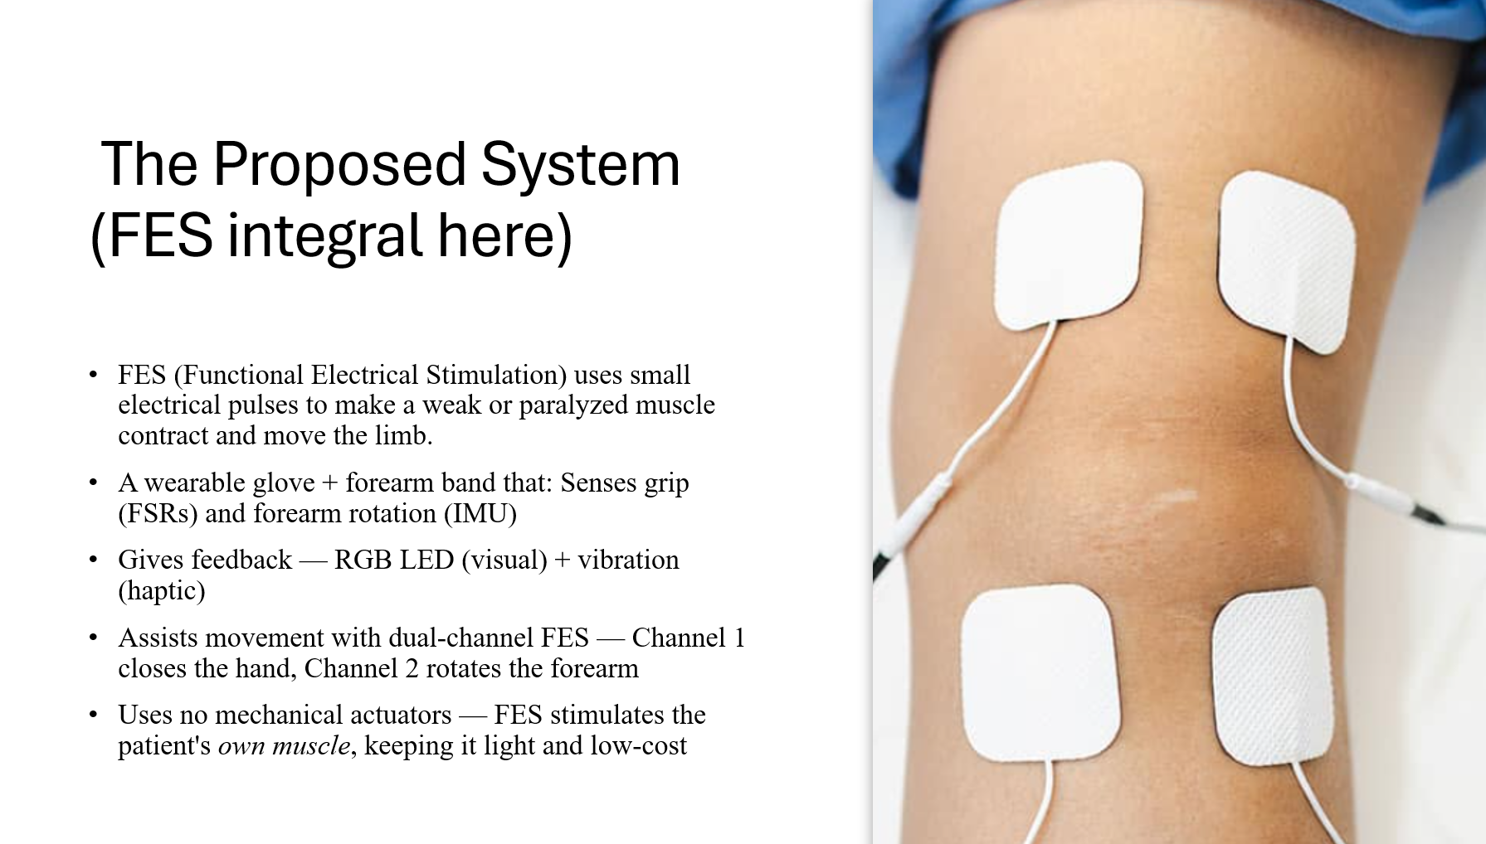

Slide 5
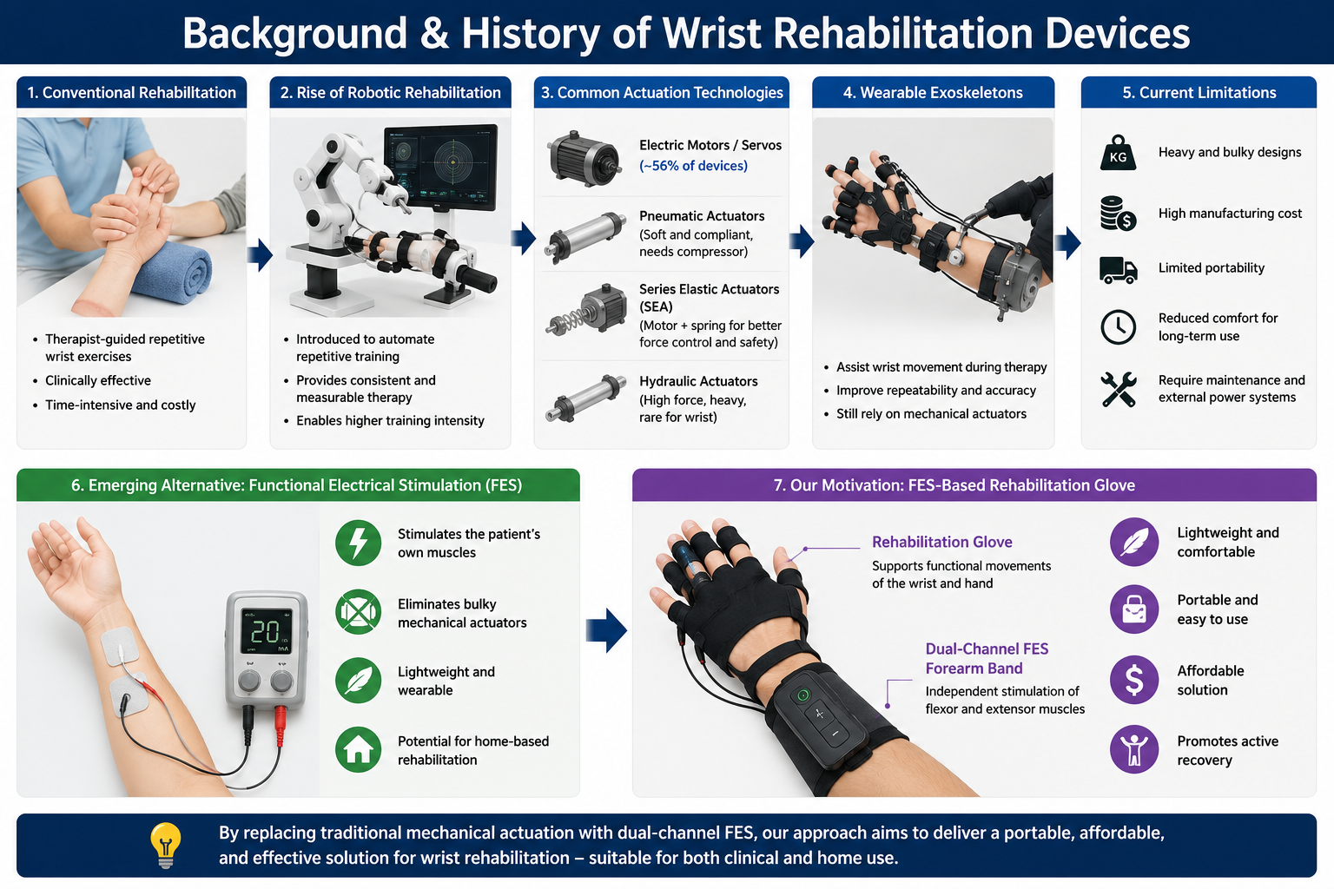
Background & History

Slide 6
The Core Research Gap:
While many haptic gloves focus on finger flexion/grasping, assisted wrist rotation remains a major gap in wearable, lightweight rehabilitation devices.
Our Solution & Contribution:
Eliminating mechanical actuators completely by integrating a dual-channel FES system directly into a lightweight glove and forearm band framework.
Key Literature Insight:
By shifting the heavy actuation load from motors to the patient’s own muscles we bridge the gap between effective wrist rotation therapy and true device portability.

Slide 7
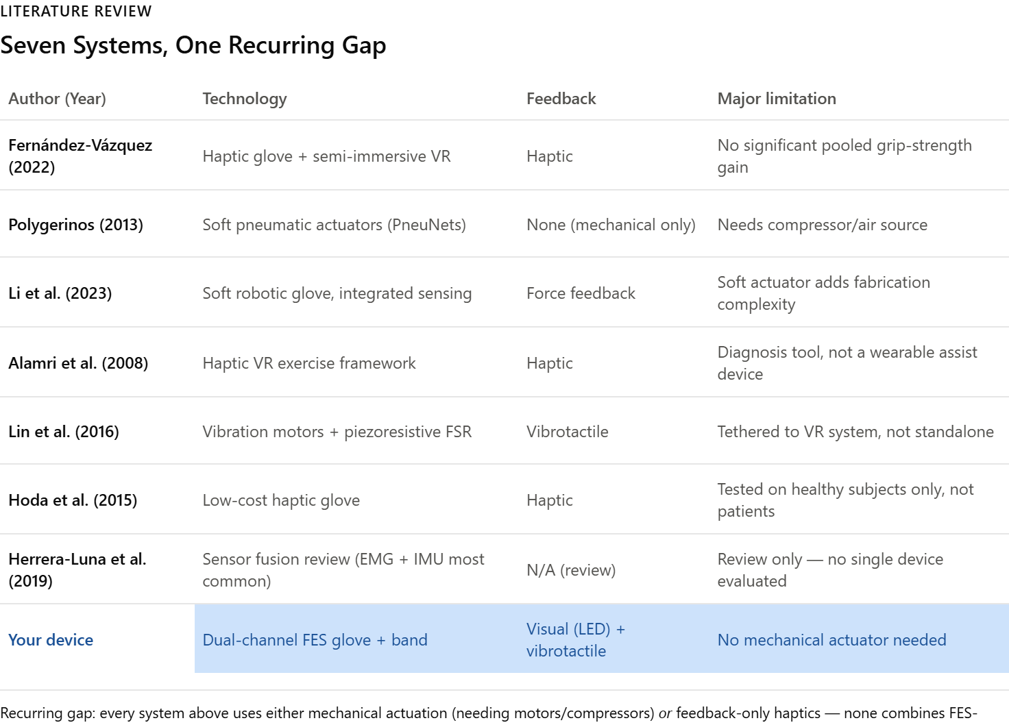

Slide 8
Development Process
Literature Review
Requirement Analysis
System Design
Hardware Development
Software Development
Prototype Integration
Testing and Evaluation

Slide 9
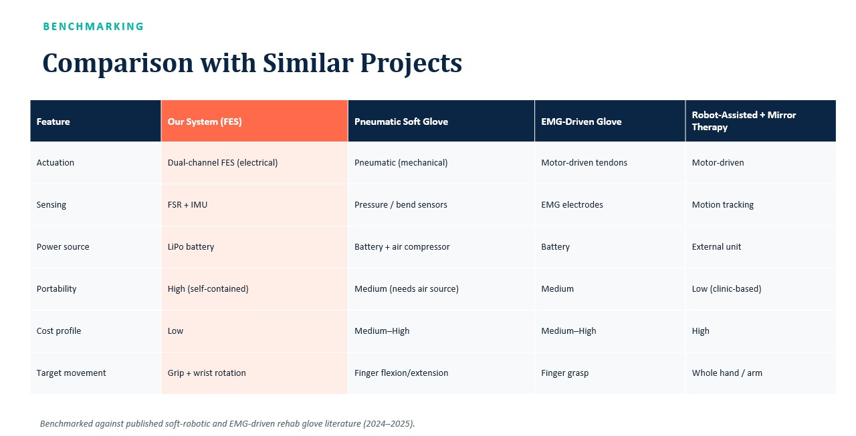

Slide 10
Literature Baseline vs. Your System Parameters
Evaluation Metric | Traditional Mechanical Baselines(Motors, Pneumatics, SEAs) | Your Proposed System(Dual-Channel FES)
Actuator Weight | Heavy 300 g to 1.5kg due to motors/gearboxes | 0 g (Uses patient's own forearm muscles)
Total Device Mass | Bulky, structurally rigid exoskeleton framework | Less than 150g (Fabric glove + lightweight forearm band)
System Cost | High between €200 to €1200 for active robotic joints | Low Cost (less than 200)
Portability | Tethered/Desktop grounded (Requires compressors/external power blocks) | Fully Portable (Battery-powered, wearable hub)
Target Wrist Action | High structural complexity to align mechanical joints to the forearm | Seamlessly Integrated via targeted electrode placement on Pronator/Supinator muscles

Slide 11
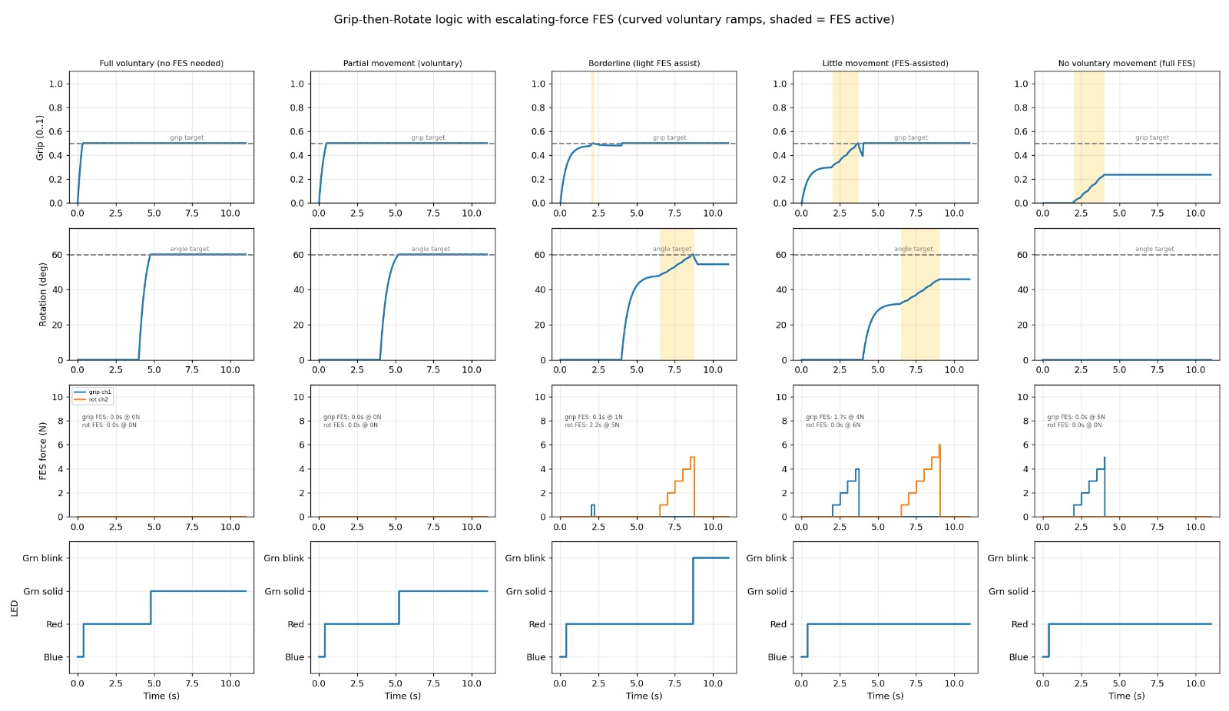
Result

Slide 12
Limitations
Electrode placement sensitive
Muscle fatigue during long use
Requires user-specific calibration
Future Scope
AI-based adaptive stimulation
Clinical validation studies
Improved wearable electrodes
Mobile app

Slide 13
Thank you

